Slide 1
Working with hdfs commands
Learn it the practical way
https://github.com/saranshsk/bigdata
Hostname available at - https://github.com/saranshsk/bigdata/blob/master/ipaddress.txt
1st level login:
Username - gatewayuser
Password - 12345
2nd level login: type ssh hadoop@edgenode
Username - hadoop
Password - hadoop

Slide 2
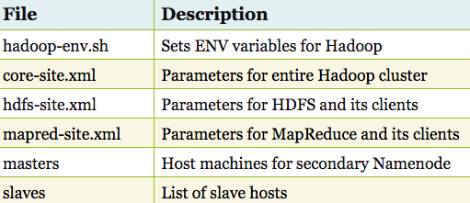
Files description

Slide 3
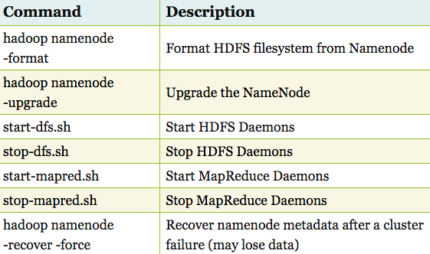
Admin commands

Slide 4
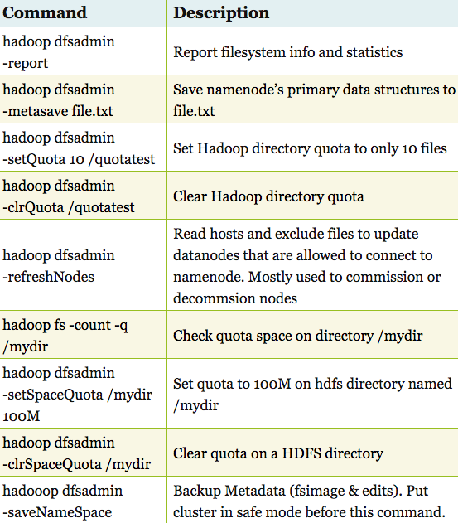
Admin commands cont.…

Slide 5
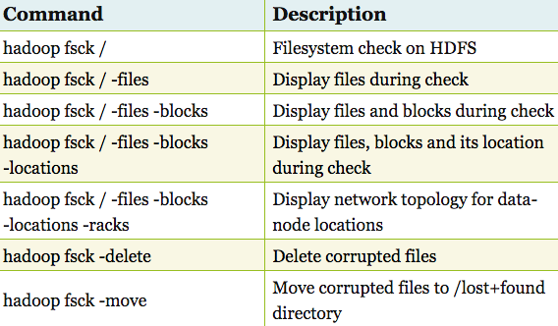
File system check commands

Slide 6
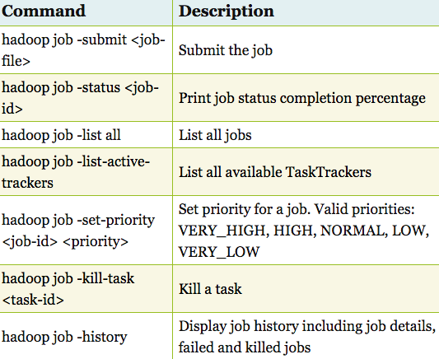
Job related commands

Slide 7
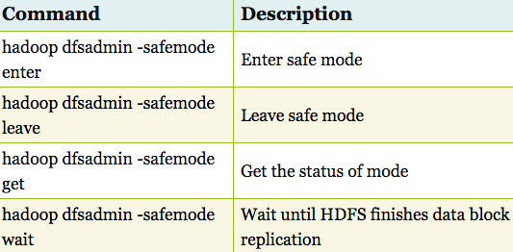
Safemode commands

Slide 8
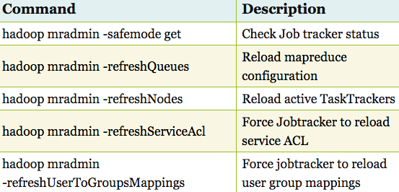
Map-reduce commands

Slide 9
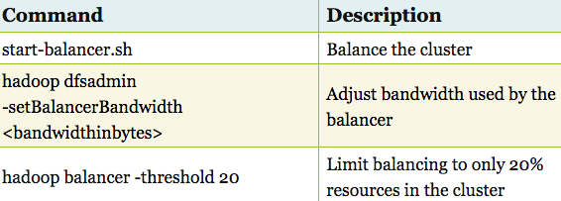
Load balancer commands

Slide 10
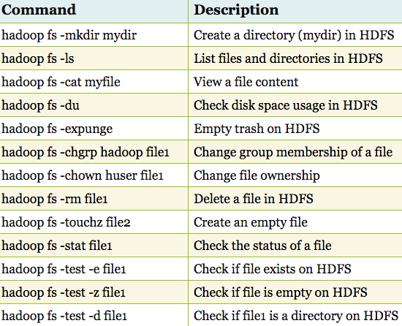
File system commands

Slide 11
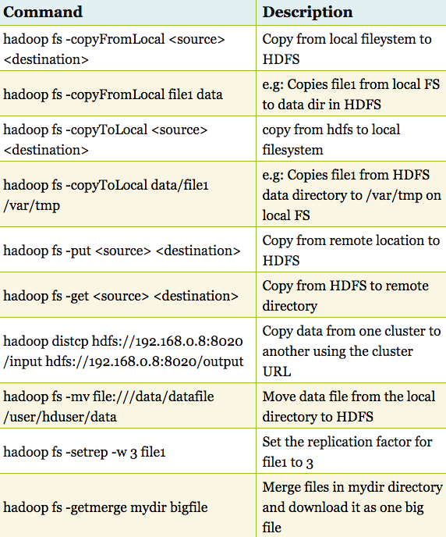
File system commands cont.

Slide 12
With this session we have learnt how to work on hdfs using commands
Learn It The Practical Way:
https://github.com/saranshsk/bigdata
Up Next In The Series:
diy – Installing hive on Gateway node to access the cluster

